Slide 1











Prevalence and Factors Associated with Depression and Substance Use Disorder among Healthcare Workers in Kenya: A Cross-sectional Study, 2025.
Duncan N. Kibue¹, R. Rapenda¹, A. Mudamba¹, D. Wangari², A. Mwatondo³, B. Waweru¹, C. Ndeta¹, J. Omolo⁴, J. Githuku³
¹Field Epidemiology Training Program-Kenya, Ministry of Health, Kenya ²County Department of Health, Kitui ³Africa Field Epidemiology Network ⁴County Department of Veterinary Services-Kilifi
Public health interventions towards Universal Health Coverage
Insert high-resolution institutional Logos – if available
Kenya Health Security Convention | 5th – 8th May 2026 | Mombasa - Kenya
Notes:
From the field epidemiology Training Network –Intermediate Program
Co-Authors as displayed by various institutions they come from.

Slide 2
Background
Mental health is a state of well-being that enables individuals to cope with stress, work productively, and contribute to society (WHO, 2022).
Key Stats among HCWS
  26% Global prevalence Depression (during the COVID-19 pandemic)
  82% Depression (Africa)
  51.7% Substance Use (Kenya)
  Causes
  Duration of medical training
  Stress
  Burnout
  Fear of failure
  Compassion fatigue
  Frequent contact with illness and death (Shah 2025)
Impact
  Medical errors
  Absenteeism
  Reduced productivity
Keynote: Healthcare workers are a high-risk group for mental health and substance use disorders
Notes:
According to WHO mental health is defined as a critical state of well-being that enables individuals to cope with stress, work productively, and contribute to society (WHO, 2022). However, recent data reveals a high morbidity burden among healthcare workers (HCWs).During the COVID-19 pandemic, the global prevalence of depression among HCWs reached 26% (Rezaei et al., 2022). Furthermore, the estimated lifetime risk for substance misuse stands between 10% and 15% (Amirouche et al., 2023).
In the African context, the burden of disease is even more pronounced. Studies indicate a period prevalence of depression reaching 82% among hospital staff (Rezaei et al., 2022).
Data on Alcohol Use Disorder (AUD) shows high regional variations, with a prevalence of 21% in South Africa (Oup, 2023), 20% in Nigeria (Okwelum et al., 2024), and 17% in Kenya (Shah et al., 2025). Notably, recent data from Kenya indicates a lifetime prevalence of substance use at 51.7% among HCWs (Shah et al., 2025).The etiology of these mental health outcomes is multifactorial. Key risk factors include prolonged medical training, chronic occupational stress, burnout, and compassion fatigue (Shah et al., 2025). These stressors act as determinants that increase vulnerability to depressive disorders and substance use.Ultimately, these conditions function as proximate causes for adverse systemic outcomes, including increased rates of absenteeism and a higher incidence of medical errors, directly compromising healthcare delivery and patient safety

Slide 3
Background
Policy Context in Kenya:
  Kenya has developed frameworks such as;
    Kenya’s Mental Health Policy (2015–2030)
    National guidelines on Workplace Mental wellness (2023)
      Despite these efforts, level of implementation remains unclear.
Knowledge Gap
  Limited data on:
  The prevalence of depression and substance use disorders among HCWs.
  The factors associated with these conditions.
Notes:
The rationale for this study is simple: we have the right policies, but we lack the data to make them work. Kenya has solid frameworks like the 2023 Workplace Mental Wellness guidelines, yet we don't know if they are actually being put into practice.We are facing a major information gap. We don't have clear figures on how many healthcare workers are struggling with depression or substance use, and we don't fully understand the root causes behind these issues. This study is necessary to provide the hard evidence needed to move from general policy to real-world support for our staff

Slide 4
Objectives
  Main Objective
  To determine the prevalence of depression and substance use disorder and associated factors among healthcare workers in Kenya.
  Specific Objectives
  Determine the prevalence of depression and substance use disorder among HCWs in Kenya.
  Identify factors associated with depression and substance use disorder among HCWs in Kenya.
  Evaluate the level of implementation of Workplace Mental Health Guidelines (2023) in selected health facilities in Kenya.

Slide 5
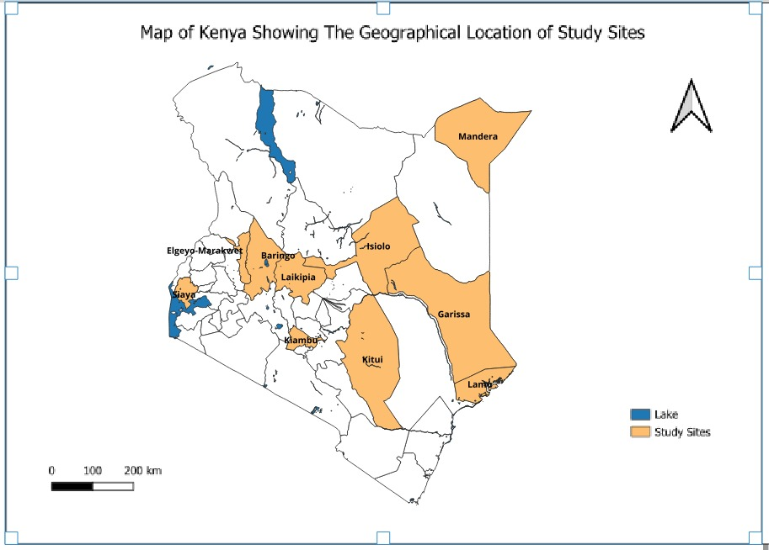
Methodology
Study design:
  Cross-sectional study
Study setting:
    Government health facilities in 10 counties
Study population:
  Healthcare workers-
    Doctors
    Pharmacists
    Nurses
    Clinical officers
    Pharmaceutical technologists
    Laboratory personnel.
Inclusion criteria:
    In service ≥ 6 months
    Direct patient care
    Facility managers ( Guidelines on workplace mental wellness)

Slide 6
Methodology
STEP 1: SAMPLE SIZE CALCULATION
Cochran's formula + FPC + 10% non-response n = 1,119
STEP 2: SAMPLING 30 facilities (3/county) Stratified by cadre → Random Selection of HCWs
STEP 3: DATA COLLECTION TOOL Kobo Collect (self-administered) Employee Mental Wellness Assessment + Organizational Wellness Assessment (facility managers)
STEP 4: INSTRUMENTS PHQ-9 (Depression) MBI (Burnout) | DAST-10 (Substance Use)
STEP 5: ETHICS Authorization (County Directors +Medical Superintendents) Informed Consent (all participants)
STEP 6: DATA ANALYSIS Descriptive (frequencies, proportions) Bivariate (OR, 95% CI, p<0.05

Slide 7
Results: Distribution and Prevalence of Depression/SUD among HCWs, Kenya 2025 (n=604)
Variable | Category | Frequency(%) | Depression (%) | SUD (%)
Overall prevalence | Depression | 37 (6.13%)
 | SUD | 58 (8.9%)
Gender | Female | 277 (45.86%) | 3.31% (20/277) | 1.99% (12/277)
 | Male | 327 (54.14%) | 2.81% (17/327) | 6.79% (41/327)
Age (detailed) | 20-29 years | 99 (16.39%)
 | 30-39 years | 304 (50.33%)
 | 40-49 years | 163 (26.99%)
 | 50+ years | 38 (6.29%)
Age (grouped) | 18-44 years | 493 (81.62%) | 4.97% (30/493) | 6.95% (42/493)
 | >44 years | 111 (18.38%) | 1.16% (7/111) | 1.82% (11/111)
Years of experience | >10 years | 240 (39.74%) | 2.48% (15/240) | 3.14% (19/240)
 | <10 years | 364 (60.26%) | 3.62% (22/364) | 5.63% (34/364)

Slide 8
Results: Distribution and Prevalence of Depression/SUD among HCWs, Kenya 2025 (n=604)
Variable | Category | Frequency (%) | Depression (%) | SUD (%)
Cadre (detailed) | Nurse | 212 (35.10%)
 | Clinical Officer | 145 (24.01%)
 | Laboratory | 105 (17.38%)
 | Medical Officer | 67 (11.09%)
 | Pharmacy | 75 (12.42%)
Cadre (grouped) | Nurse | 212 (35.10%) | 2.81% (17/212) | 1.82% (11/212)
 | CO/Pharm/Lab/MO | 392 (64.90%) | 3.31% (20/392) | 6.95% (42/392)
Workplace wellness Assesment | Conducive Work Environment (<60%) | 304 (50.33%)
 | Personal Wellness (≥60%) | 306 (50.66%)
 | Organization/Employer Support (<60%) | 357 (59.11%)
 | Manager Support (≥60%) | 424 (70.20%)

Slide 9
Results: Factors Associated with Depression Among HWCs In 10 Selected Counties in Kenya July-August 2025.

Slide 10
Results: Factors Associated with SUD Among HWCs In 10 Selected Counties in Kenya, July-August 2025.

Slide 11
Results: Facility Adherence In Implementing of Workplace Mental Wellness Guidelines in 10 Selected Counties Kenya July- August 2025
Variable |  | Frequency (n=30) | Proportion (%)
Availability of workplace policy |  | 6 | 20.00%
Existence of mental committee |  | 9 | 30.00%
Provision of training for managers |  | 11 | 36.67%
Medical plan covers physical and mental health |  | 22 | 73.33%
Access to Employee Assistance Program (EAP) |  | 12 | 40.00%
Availability of flexible work arrangements |  | 26 | 86.67%
Mental health surveys conducted annually |  | 4 | 13.33%

Slide 12
Discussion
Depression and substance use disorders among healthcare workers were lower than previously reported in Kenyan and African studies (Musili et al., 2024).
  Post-pandemic recovery or underreporting due to stigma.
•Gender patterns:
  Depression was slightly higher among females
  SUD significantly higher in males
      Comparable with a study done by (Shah et al. 2025).
Cadre differences:
  Substance use disorders were more common among non-nursing cadres compared to nurses.
    Possible differences in work-related stress or coping mechanisms, as supported by similar research (Shah et al., 2025).
Workplace factors: The majority of participants reported poor organizational support and an unfavorable work environment, despite relatively good manager support.
  Suggests systemic vs supervisory gaps – policies not fully implemented.
No significant social demographic factors for depression
  Likely due to low overall prevalence limiting statistical power.
Notes:
To begin, recent data from Musili and colleagues reveals that depression and Substance Use Disorder—or SUD—among Kenyan healthcare workers currently stand at 6.1% and 8.9%.
These figures are notably lower than previous estimates, which have historically reached as high as 82% for depression and 17% for SUD. This shift likely points to a period of post-pandemic recovery, though we must remain mindful that stigma may still lead to underreporting. When we look at gender, we see patterns that mirror findings by Shah et al. in 2025: while depression is slightly more prevalent in females at 3.3%, SUD is significantly higher in males, who are more than three times as likely to be affected as their female counterparts.Moving to professional roles, there is a clear ‘cadre gap.’ Non-nurse cadres—including medical officers, pharmacists, and lab technicians—demonstrate a significantly higher risk for substance use, with rates nearly four times higher than those seen in nurses. This disparity highlights a need for targeted interventions. Interestingly, the data also uncovers a 'systemic gap' in our workplace culture. While 70% of staff report strong support from their immediate managers, over half rate their broader organizational environment as poor. This suggests that while individual supervision is effective, institutional policies are not yet being fully implemented on the ground. Finally, although this study found no significant socio-demographic links to depression, this is likely due to the low overall prevalence, which limited the statistical power to identify those specific trends

Slide 13
Conclusion
RECOVERY vs. STIGMA
Lower reported rates may signal recovery rate, but stigma would like cause underreporting.
TARGETED VULNERABILITY
Mental health issues are not uniform across the workforce.
There is a clear gender and cadre divide, with depression peaking in females and substance misuse being markedly higher in male, non-nursing professionals.
POLICY GAP
Despite having clear Workplace Mental Health Guidelines (2023), HCWs still report poor organizational support, indicating that policies have yet to translate into safer, more supportive work environments.
KEY OUTCOME
The mental health crisis among Kenyan healthcare workers is systemic. Solutions must focus on INTISTUTIONAL REFORMS to protect the healthcare workforce

Slide 14
KEY IMPLICATIONS & RECOMMENDATIONS
KEY IMPLICATIONS:
• SUBOPTIMAL POLICY: 2023 Guidelines lack enforcement at the facility level.
• INSTITUTIONAL FAILURE: 59% report inadequate organizational support; 50% poor environment.
• VULNERABLE CADRES: Males & Non-nursing staff (CO, Pharm, Lab, MO) need tailored SUD screening.
RECOMMENDATIONS:
1. SCALE UP: Enforce 2023 Wellness Guidelines across all County health facilities.
2. MONITOR: Conduct annual wellness surveys to track prevalence & identify hotspots.
3. TRAIN: Target managers to shift from personal support to systemic organizational support.
4. INTEGRATE: Embed mental health into existing Occupational Health & Safety (OHS) frameworks
ESTABLISH EMPLOYEE ASSISTANCE PROGRAMS (EAPs)
Shift the focus from 'Individual Resilience' to 'Institutional Safety Nets'
Notes:
we are currently facing an implementation gap that undermines our clinical outcomes. While the 2023 Workplace Mental Wellness Guidelines provide a strategic framework, our surveillance data reveals a suboptimal translation to the facility level, with 59% of staff reporting inadequate organizational support and 50% characterizing their work environment as poor. We must shift from passive guidelines to active epidemiological monitoring, utilizing annual wellness surveys to identify emerging burnout hotspots and geographic clusters of distress. Furthermore, our interventions must be cadre-specific; the data indicates a higher latent risk for substance use disorders and mental health morbidity among males and non-nurse cadres—specifically Medical Officers, COs, and laboratory personnel. By integrating mental health into existing Occupational Health and Safety (OHS) frameworks and establishing facility-based EAPs, we transition from reactive crisis management to a proactive, evidence-based mitigation of workplace-related morbidity.

Slide 15






Thank you!
Scan to visit our website
#KeHSCon2026
@NPHIKenya
www.nphi.go.ke

